Slide 1
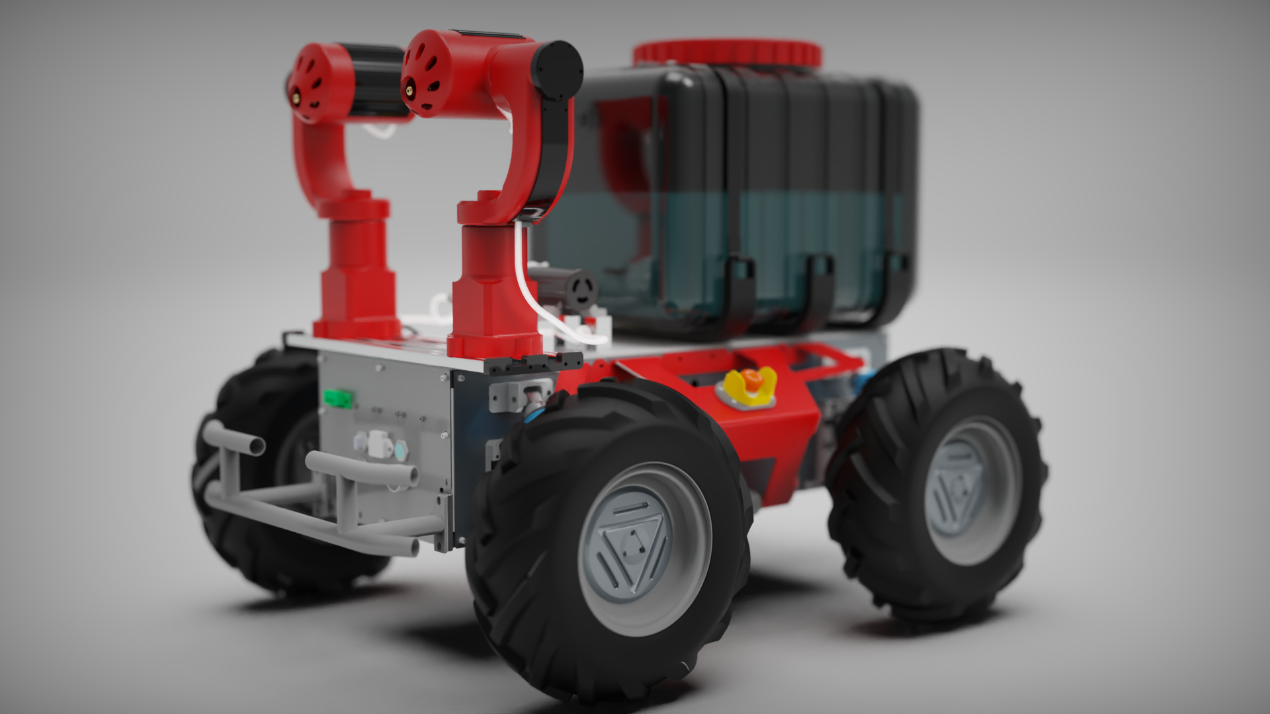
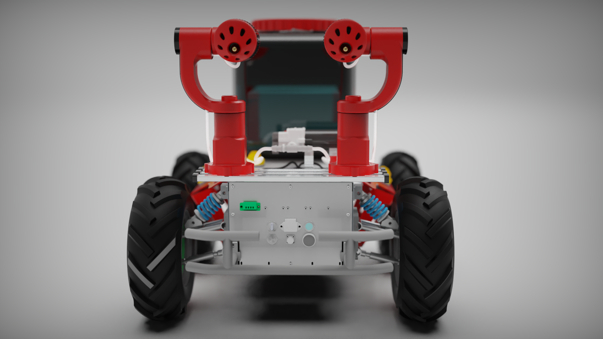
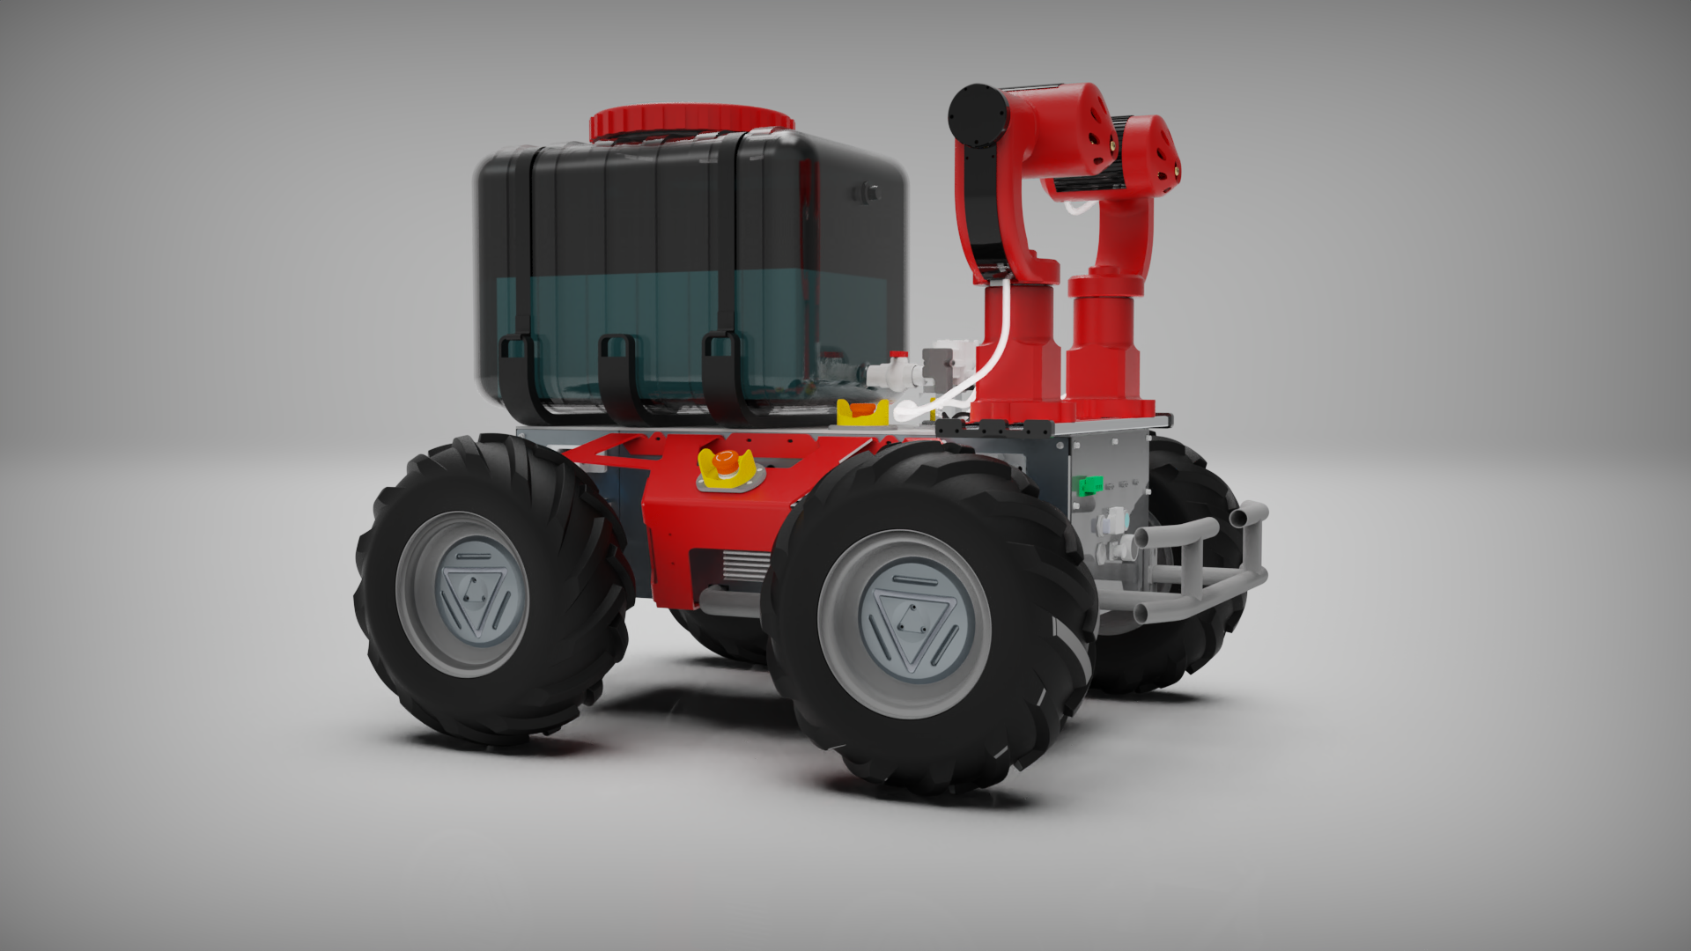

PARC Engineer's League 2025
DAUST TEAM: Prince Gildas Mbama Kombila, Mohammed Ndoye, Babacar Ndiaye

Slide 2
The Challenge
Global Challenge
Precision Need
Modern must sustainably increase productivity to feed a growing population
Precise application of resources (liquid fertilizers, water) is essential to maximize yields, reduce costs, and protect the environment
Competition Goal
Design a sprayer that can be integrated with the "PARC AgRobot" for efficient, autonomous fertilizer application

Slide 3
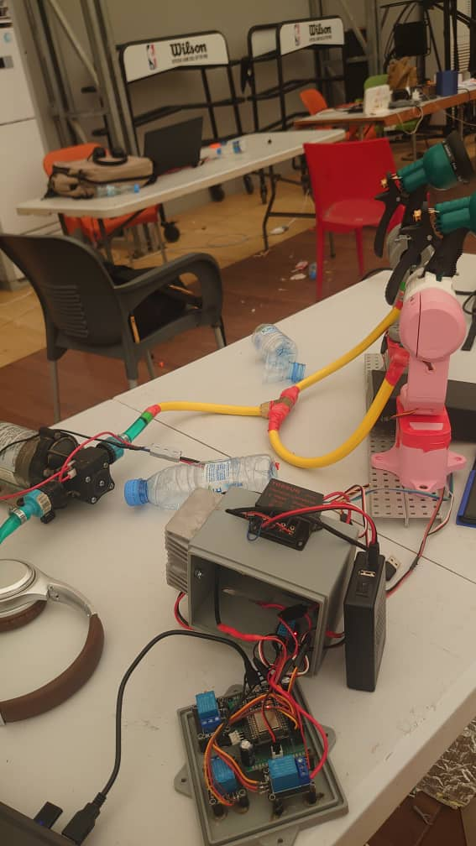
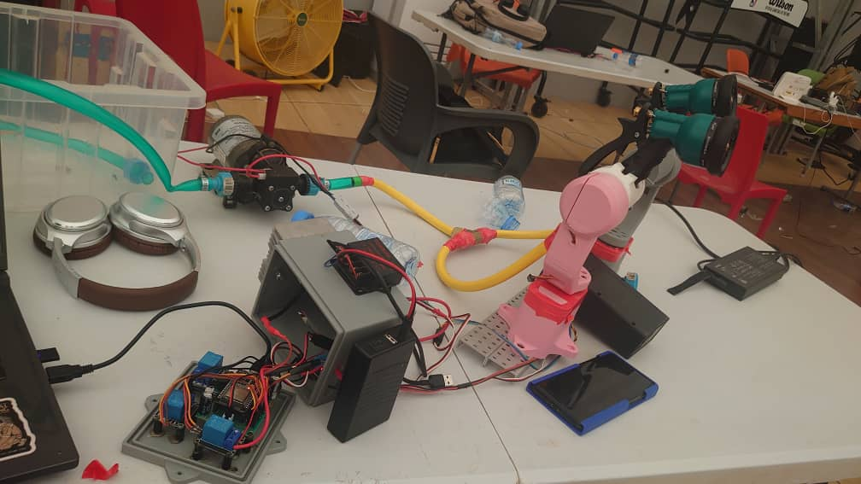
Our Solution: "Plug & Spray“(Prototype)
We've designed a lightweight, intelligent spraying module that easily attaches to the robot:
Modular design: autonomous block (mechanical, electronic, fluidic)
Lightweight: 3D printed parts and compact servomotors
Intelligent control: ESP32 microcontroller with wireless control via mobile app

Slide 4
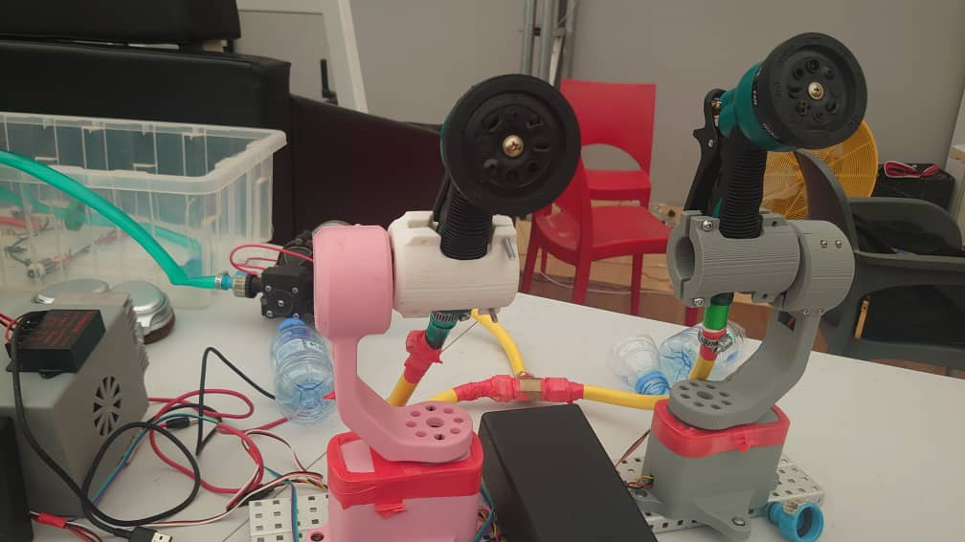
How does it work?
The ability to aim the spray is controlled by a two-axis gimbal system for each spray head.
Actuators: We use lightweight servo motors for articulation.
Pan Axis (Horizontal): A high-torque Hitec HS-805BB+ servo (24kg) rotates the entire arm assembly left and right, allowing the system to cover a wide horizontal area.
Tilt Axis (Vertical): A standard MG996R servo (9kg) adjusts the spray head's angle up and down, controlling the spray's reach and trajectory.
Structure: The frame is built from 3D-printed components, which allows for rapid prototyping and a lightweight design, crucial for a mobile robotic platform. The base is mounted on aluminum extrusions for easy integration with the PARC AgRobot.

Slide 5
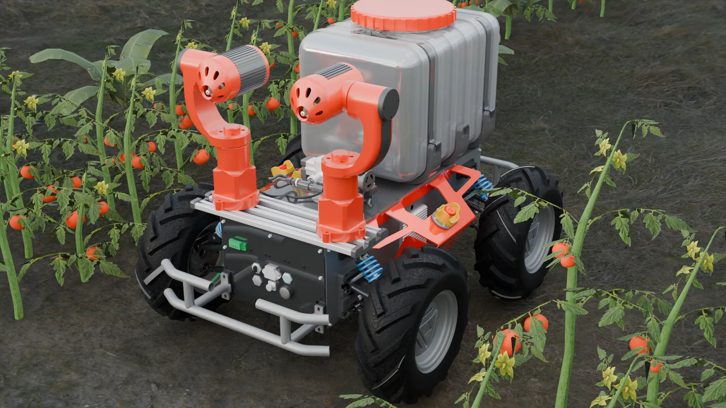

Slide 6
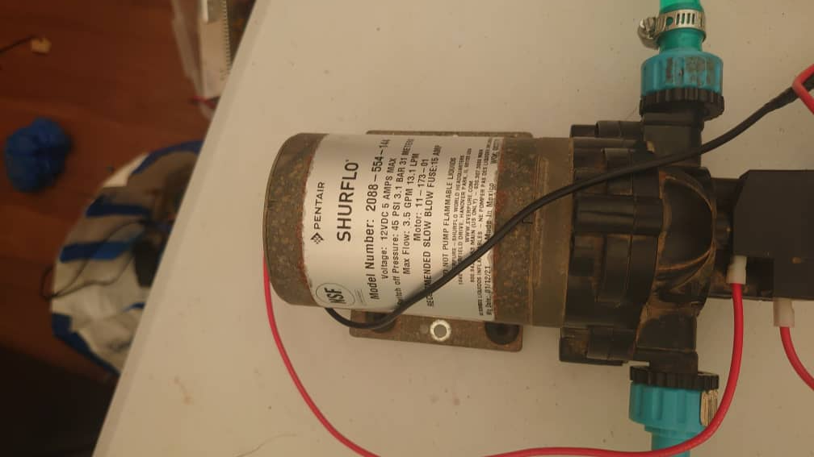
System Architecture
1
2
3
Mechanical
Fluidic
Electronics
Aluminum profiles and 3D printed parts ( PLA )
Main 12V pump for pressure
ESP32 microcontroller
Servomotors (Hitec HS-805BB+ and MG996R)
Two rotation axes (horizontal Pan, vertical Tilt) for each spray head
Spray jet mount on the system equipped with 8 modes for better control jet flow
Relay modules for 12V pumps
Custom electronic board for better cable management

Slide 7
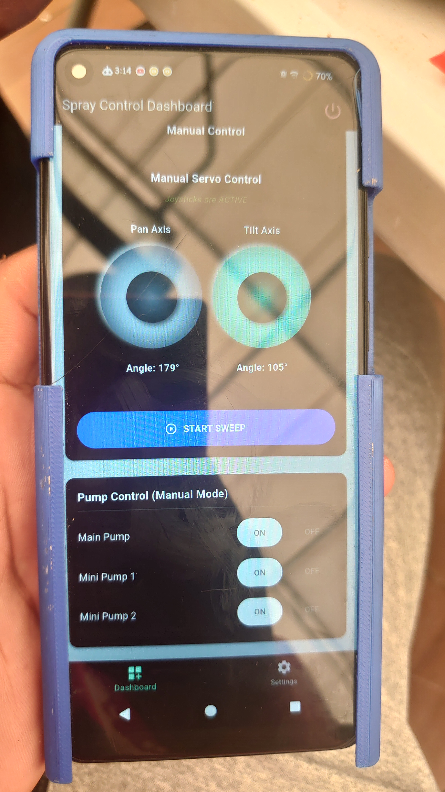
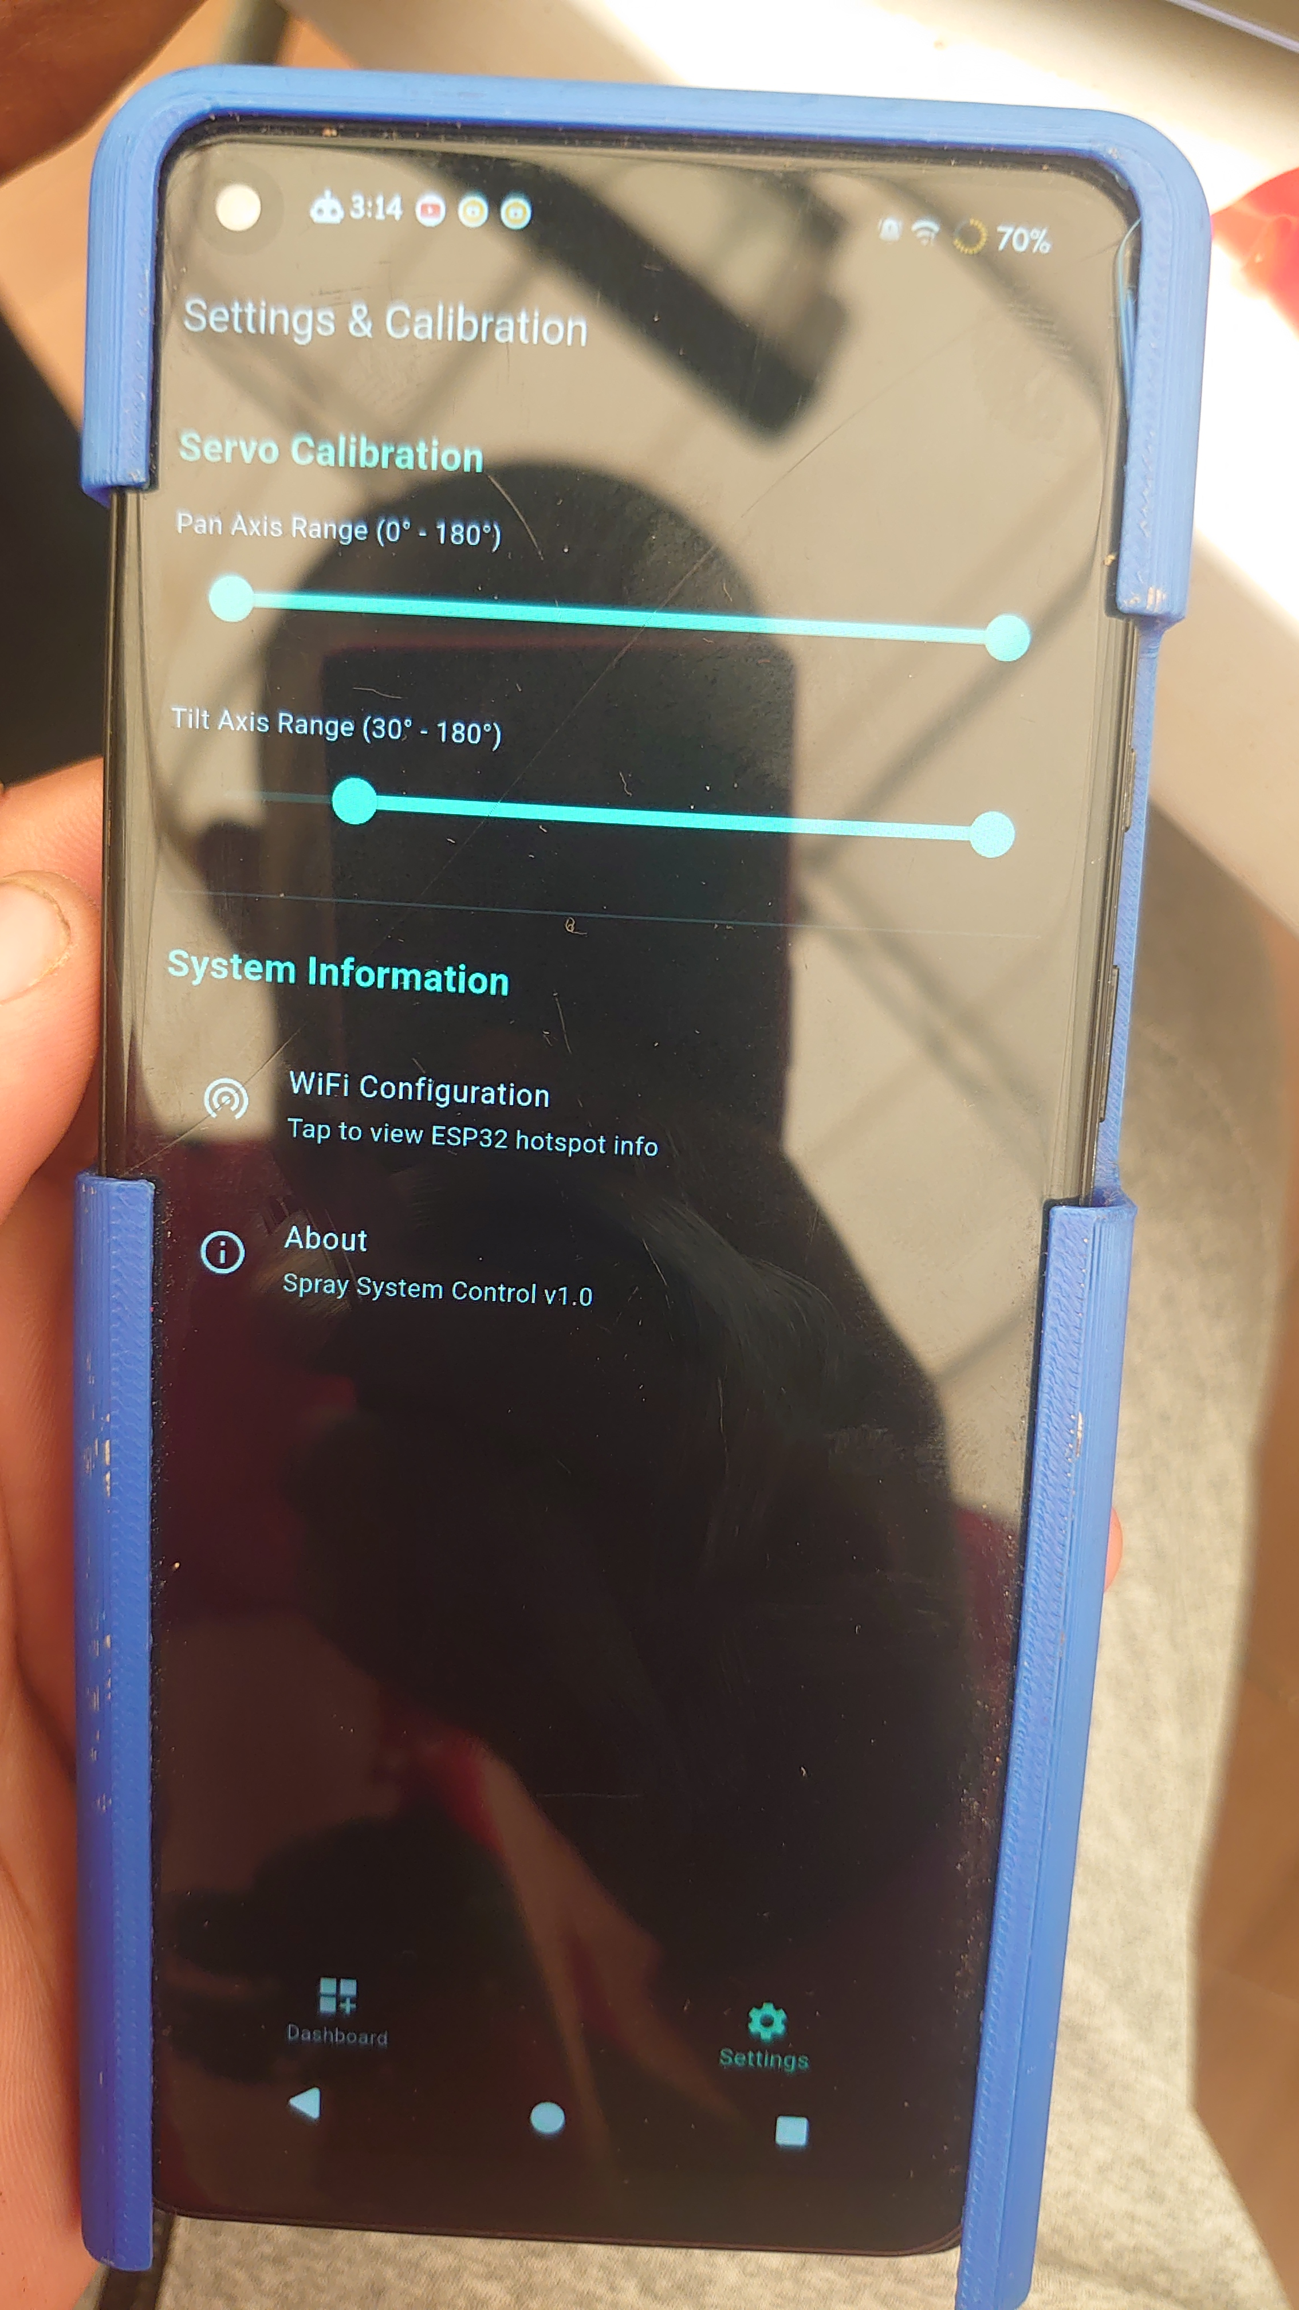
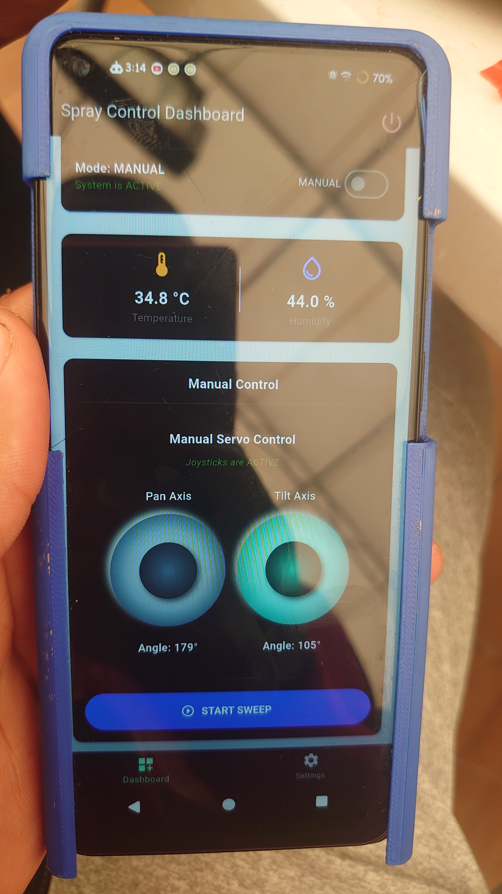
Mobile app for better control
We designed an app to control our mechanism fully remotely using Flutter Dart

Slide 8



Prototype Advantages
Low Cost
Affordable, widely available components ideal for rapid, economical prototyping
Lightweight
Servomotors create a very light system, a key advantage for mobile robots
Simple Control
Servomotors use simple PWM signals; ESP32 offers integrated wireless control

Slide 9








Application Domains
Agriculture
Industrial Maintenance
Precision application of fertilizers, pesticides, and irrigation in fields, greenhouses, vineyards
Cleaning, disinfection, and coating application in factories, hospitals, solar farms
Construction
Public Spaces
Concrete curing, waterproofing treatments, temporary ground marking
Pest control, green space maintenance, targeted firefighting with drones

Slide 10
Challenges & Future Improvements
Current Limitations
Planned Upgrades
Servomotor torque insufficient for heavy loads
Replace servos with stepper motors + planetary gearboxes
Limited durability of hobby components
Create custom PCB to replace Arduino and relay modules
Movement precision and backlash issues
Use industrial-grade components (valves, pumps, nozzles)
Power management challenges
No water proof
Hybrid structure (metal + 3D printing)
Add closed-loop sensors for flow and pressure
IP68

Slide 11
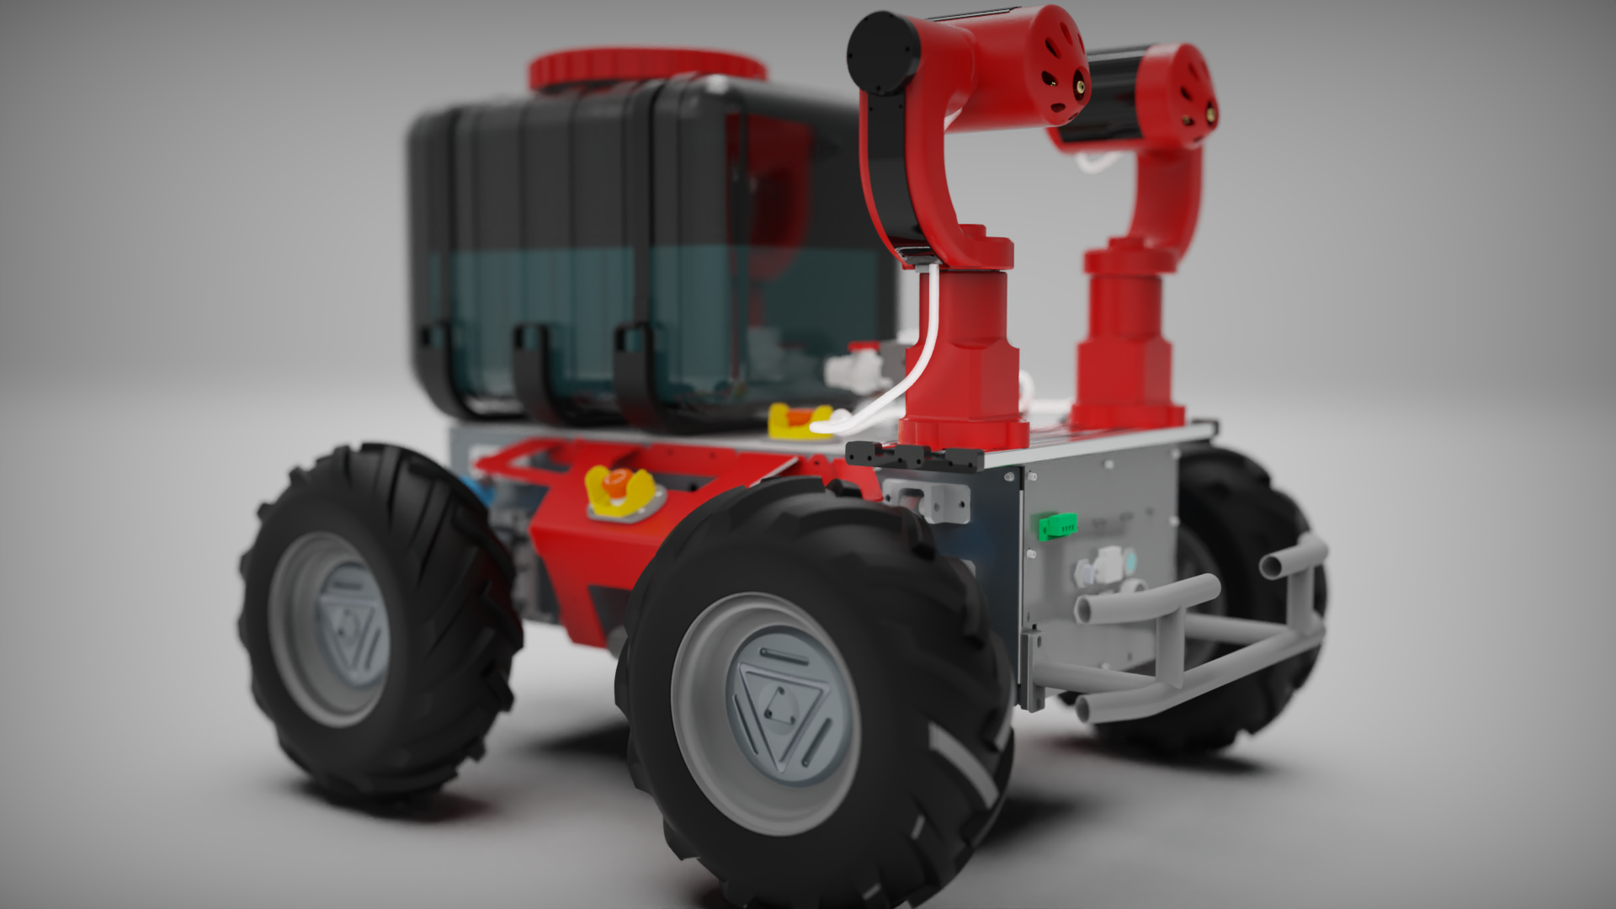
Conclusion
Successful Prototype
We've demonstrated a functional lightweight, intelligent, remotely-controlled spraying system
Clear Analysis
Identified strengths for prototyping (cost, weight) and limitations for real applications (torque, durability)
Defined Roadmap
Clear technical path to evolve this prototype into a robust, high-performance solution ready for precision agriculture

